Slide 1






YOUR JOY IS OUR GOAL.............................
reachout to us today for a refreshinly healthy life style
Prepared by JUPTECH CONSULTS

Slide 2

Project Scope and Objective
THIS PROJECT WAS DESIGNED UTILLIZING THE BEST SOFTWARE ENGINEERING PRINCIPLES AVAILABLE...............................
PROJECT SCOPE - THE PRODUCT IS AIMED AT CREATING A USER FRIENDLY PLATFORM THROUGH WHICH MEMBERS OF THE PUBLIC CAN SURF THROUGH AND PURCHASE DISPLAYED PRODUCTS FROM OUR CLIENT WITH THE ABILITY TO TRACK THE LOGISTICAL MANAGEMENT SYSTEM OF THEIR ORDER.
PROJECT OBJECTIVE- CREATING AN AVAENUE THROUGH WHICH ADUABA FRESH PROSPECTIVE CLIENTS CAN DO BUSINESS WITH ADUABA VIA A SEEMLESS PROCESS.
TIMELINE MANAGEMENT SYSTEM
week1 - grahics user interface design and end point developments
week2- refractoring of ui codes following D.R.Y concept and testing of API endpoints
week3- Api integration , testing for bugs and product deployment

Slide 3
TABLE OF CONTENT
Architectural Structure and Methdology
Graphics User Interfaces and their functionalities
LIVE demo of aduaba fresh e-commerce app

Slide 4
SOFTWARE LOGIC ARCHITECTURE
MONOLITHIC ARCHITECTURE
FLUTTER IDE
ASP.NET CORE WEB API(3.1)
MSSQL SERVER
BUSINESS LEVEL LOGIC
USER INTERFACE
Data Access Layer
users are able to register and login......
.
users aer able to reset their password and update their profilie
USERS ARE PROVIDED WITH RICH UI/UX SCREENS
DATA MODELS
users are able to add and remove items from their wishlist
user are able to remove or add items from their shopping cart
USER, CART ITEM, CARD DETAILS, ORDER ITEMS, ORDER, PAYMENT, PRODUCT, WISHLIST ITEM, USER ADDRESS, CATEGORIES, SUB-CATEGORIES
users are able to send for their desired product
users are able to pay online vis their debit cards

Slide 5
Graphics User Interface
Onboarding
Home
Discover Products
Categories
Cart and Checkout
Account
Order Tracking
PROJECT FILE ARCHITECTURAL STRUCTURE(MV-VM)
MODEL FOLDER
SCREENS FOLDER
3. SERVICES FOLDER
4. WIDGETS FOLDER
5. CONSTANTS FILE

Slide 6
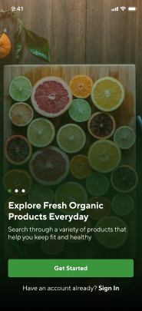
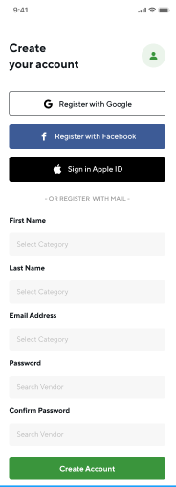
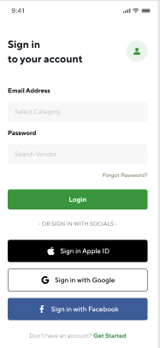
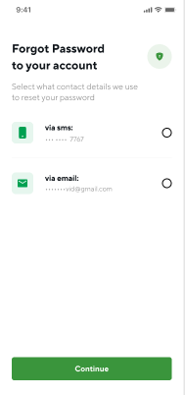
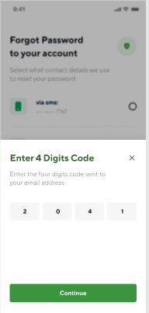

OnBoarding
THROUGH A SECURED AUTHENTICATION PROCESS, PROSPECTIVE CLIENTS/VISISTORS GET ADMITTED TO EXPLORE THE APP

Slide 7
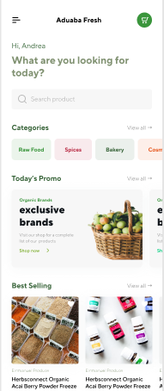
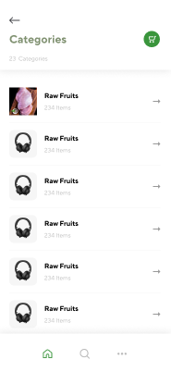
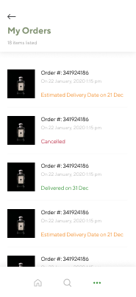
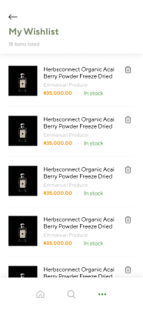
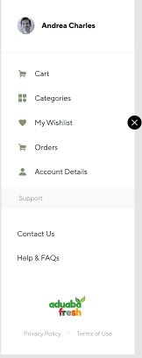
Home
AT THE HOME SCREEN, A VISITOR CAN SURF THROUGH AVAILABLE PRODUCTS AND SALES OFFERS WITH THE ABILITY TO ADD PRODUCTS THEY ARE INTERESTED IN TO CART OR WISHLIST BEFORE PLACING AN ORDER

Slide 8

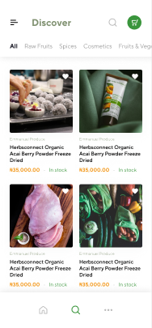
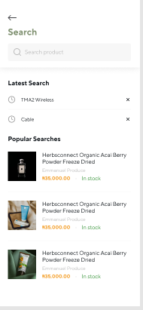

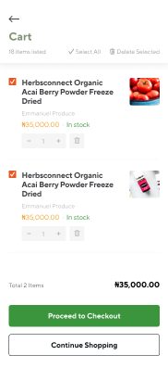
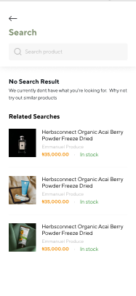
DISCOVER PRODUCT
CLIENTS CAN SEARCH DIRECTLY FOR THEIR INTENDED PRODUCT TO BE PURCHASED OR VIEWED THROUGH THE DISCOVER SCREEN AS WELL..........

Slide 9
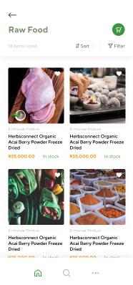
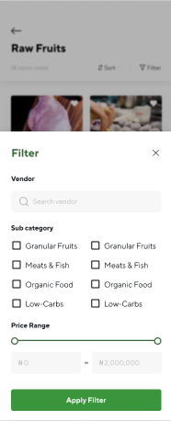
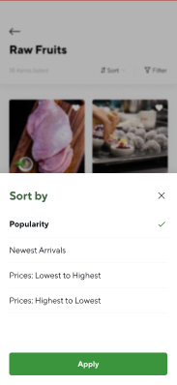
CATEGORIES
WE HAVE A PRODUCT FOR ALL PRODUCT CATEGORY AND BUDGET SIZE- SORT AND FILTER IS YOUR BEST BET

Slide 10
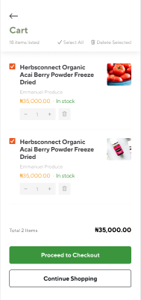
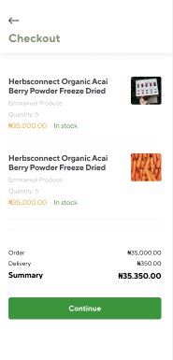
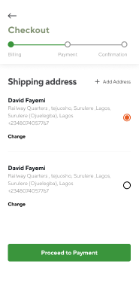
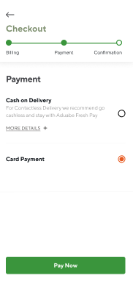
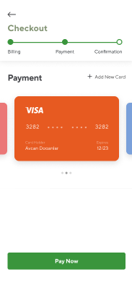
CART AND CHECKOUT
FOSTERS SEEMLESS CASH AND CASHLESS POLICY PROCEDURE AS YOU CAN CHECKOUT ITEMS IN YOUR CART WITH CONVINIENCE

Slide 11
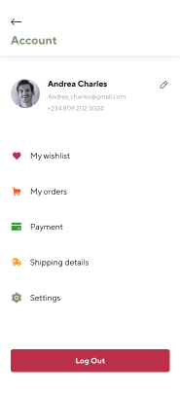
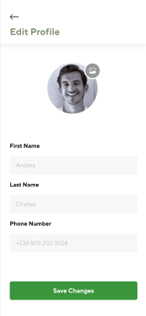
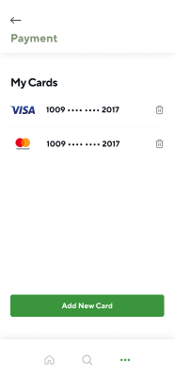
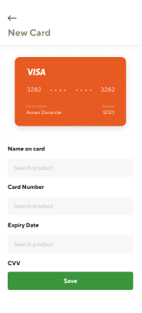
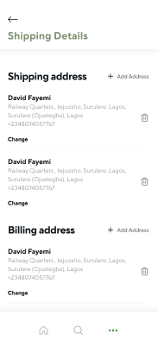

ACCOUNT
ADJUST AND UPDATE YOUR PROFILE , DELIVERY ADDRESS AND DEBIT CARD DETAILS VIA THE ACCOUNT TAB

Slide 12

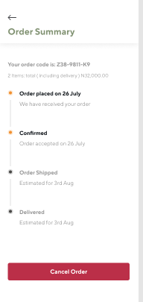
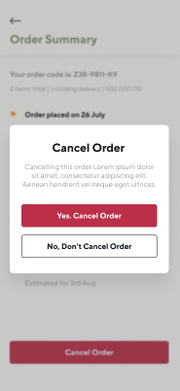
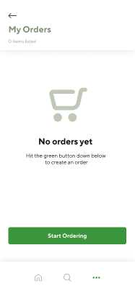
ORDER TRACKING
TRACKING OF YOUR ORDER IS POSSIBLE THROUGH A TRANSPARENT AND EXPLICIT ORDER TRACKING SYSTEM

Slide 13
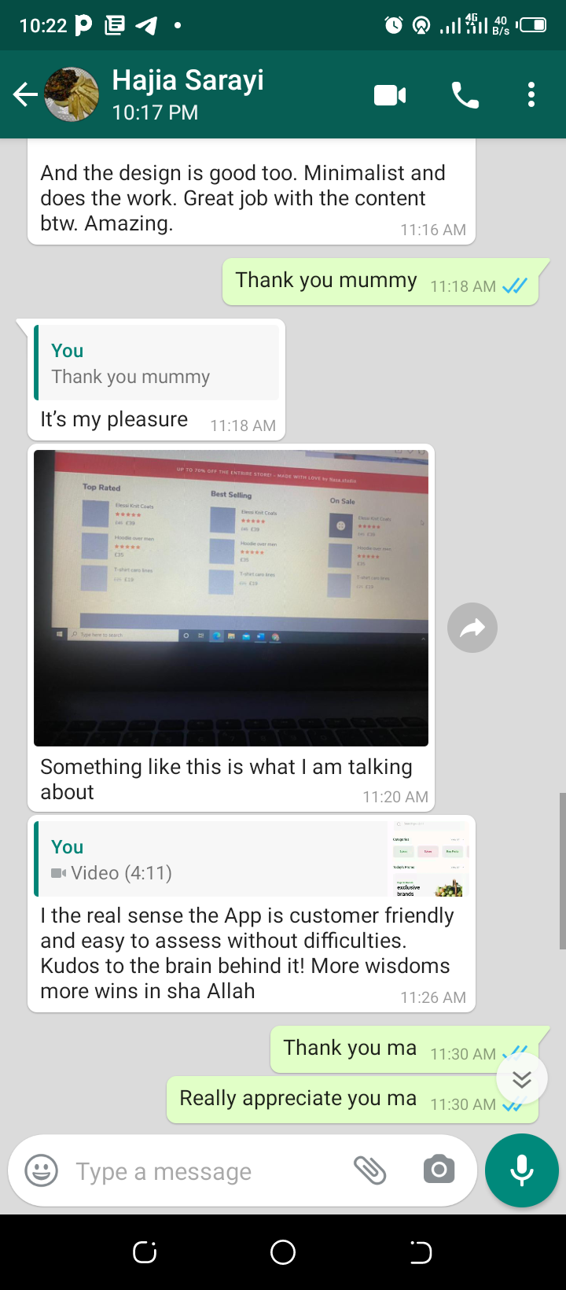
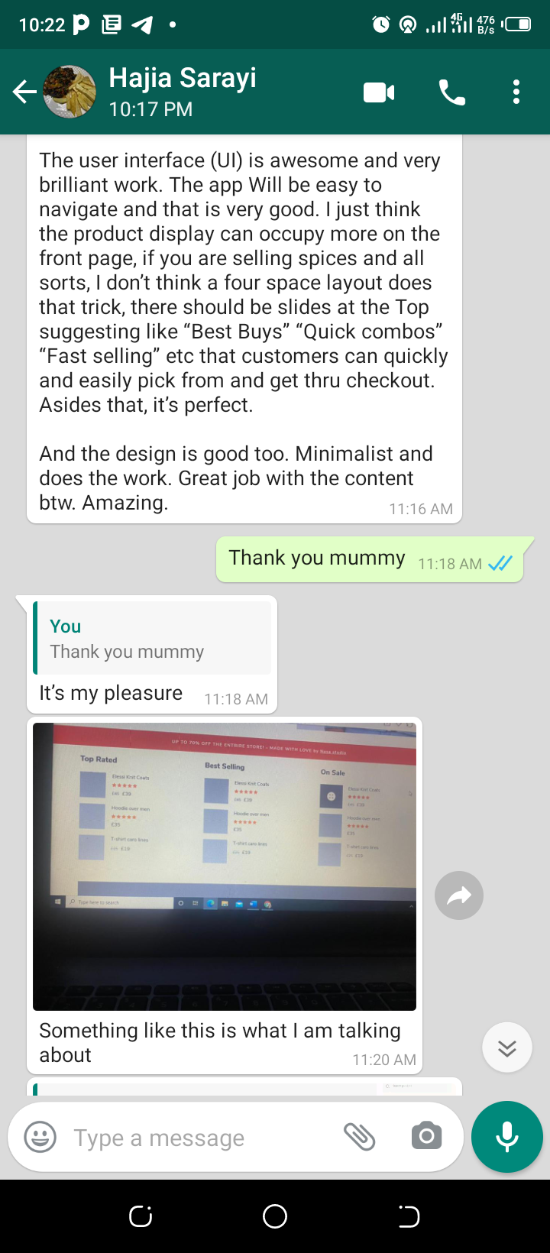
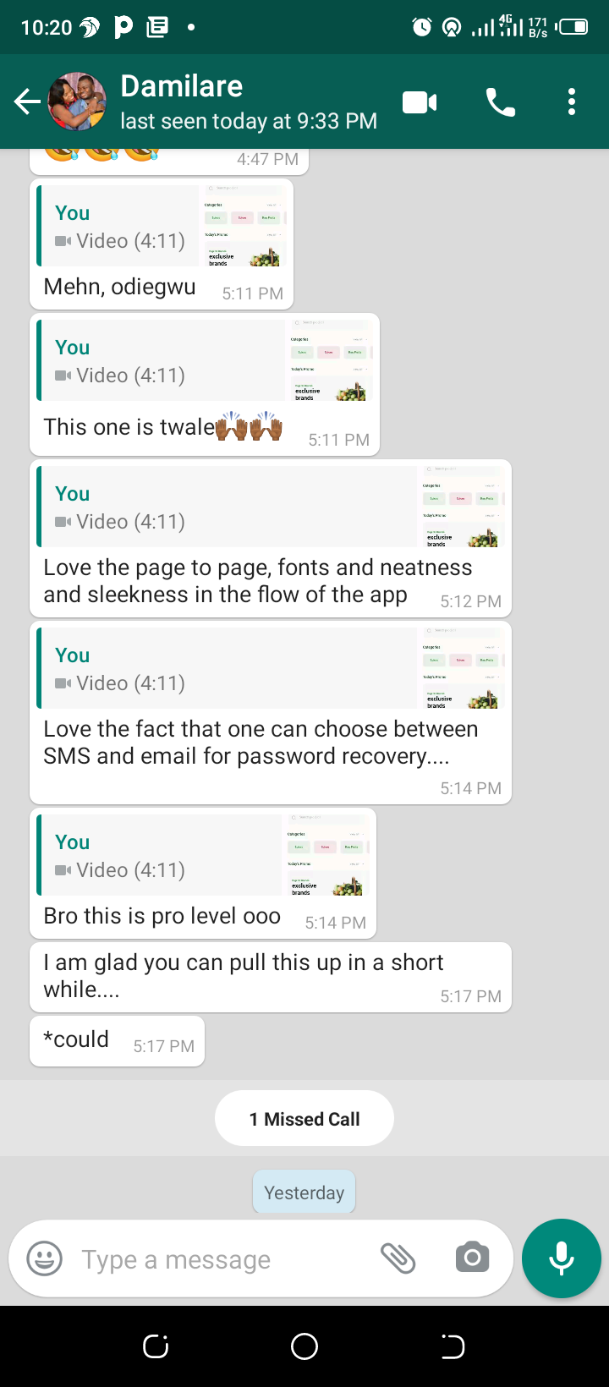
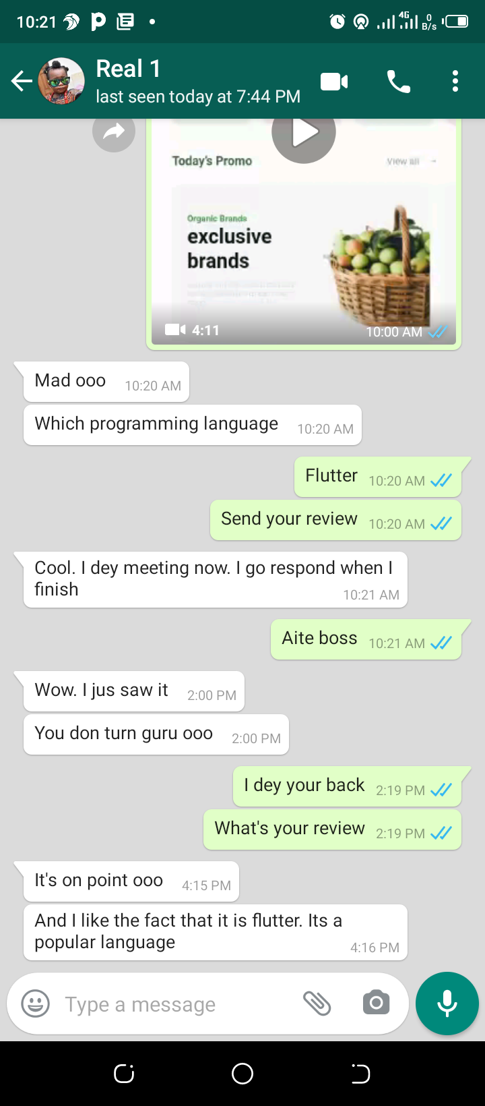
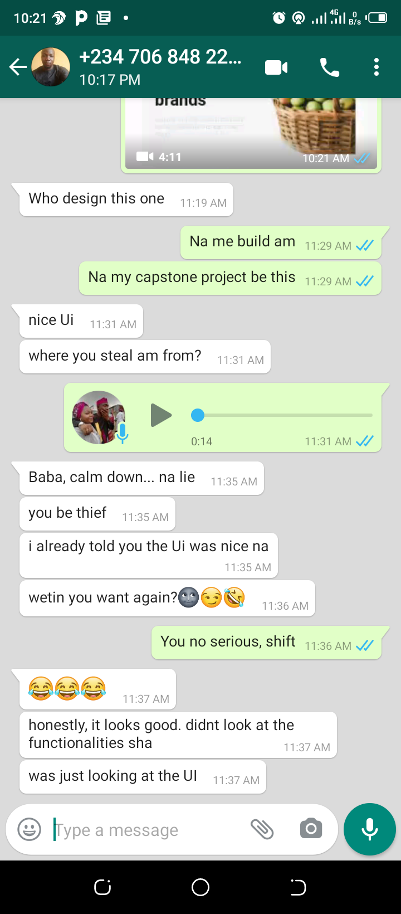
ROAD MAP - ADMIN INTERFACE MANAGEMENT PANEL
In response to the constructive criticism metted out by members of the public, our team has found it neccesary to integrate an admin panel into this project so as to make our prospective client partially independent regards their data management process.

Slide 14
A BRAND FOR EVERY FAMILY

